Slide 1
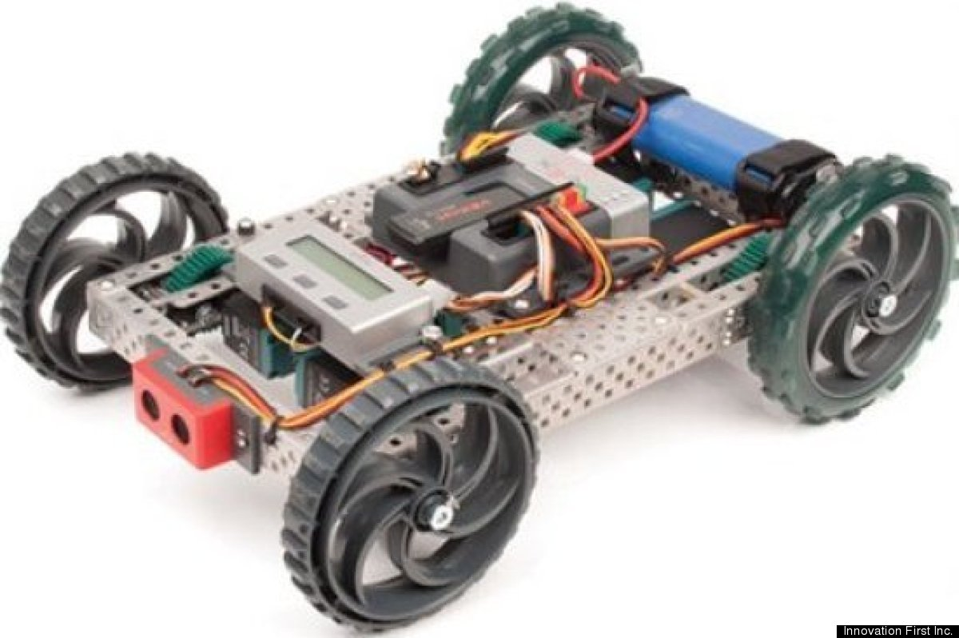
Robotic Follow-The-Leader
By Abedallah Abedrabbah, CL

Slide 2
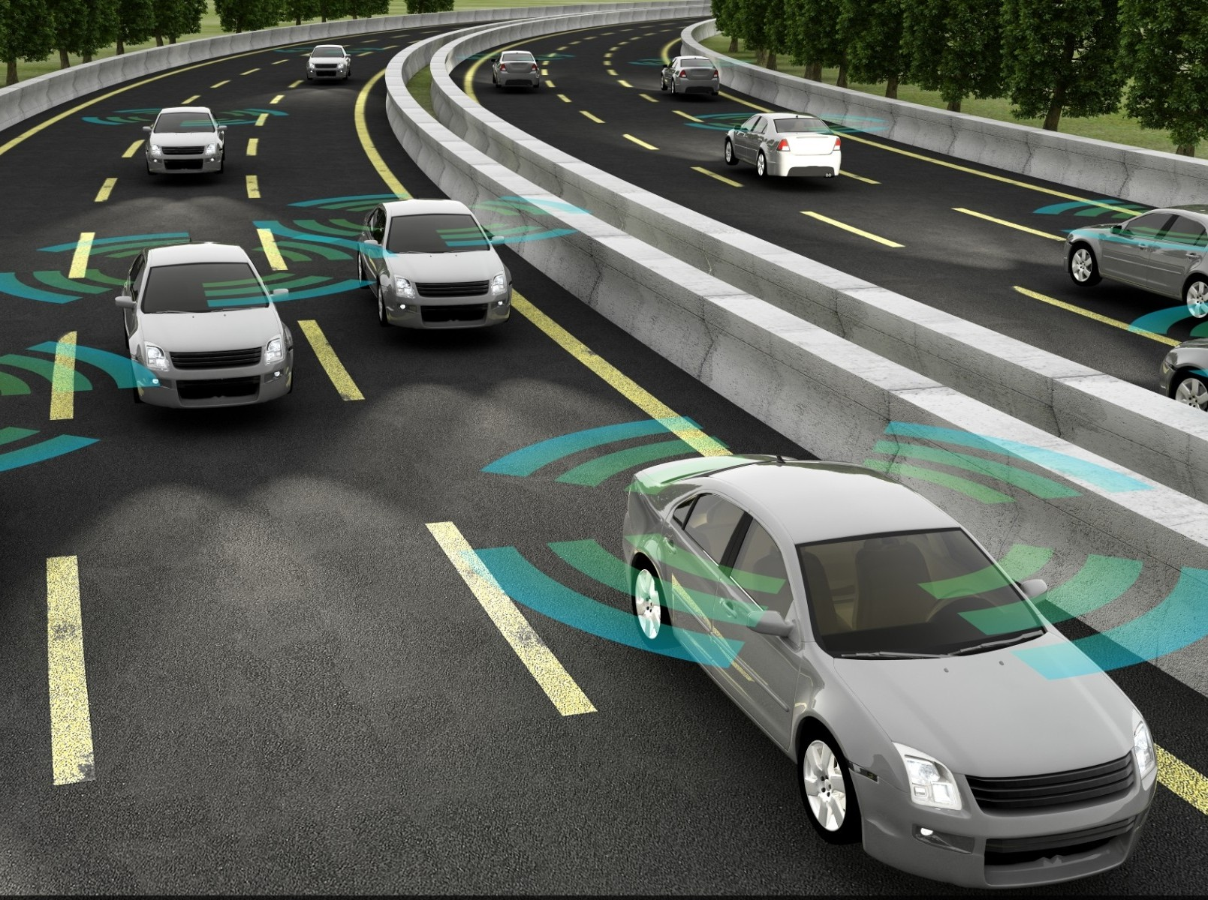
BACKGROUND OVERVIEW
Autonomous vehicles have been making huge improvements the past few years.
Big concept that many engineers are constantly trying to find new ways to incorporate into society.
Autonomous vehicles are designed to have many benefits in everyday lives.
Notes:
An autonomous vehicle is an unmanned vehicle capable of sensing its environment and navigating without human input
Potential Benefits:
reduced mobility
infrastructure costs
increased safety
increased mobility
increased customer satisfaction
significant reduction in traffic collisions

Slide 3
PROJECT DESCRIPTION
Design, build, and program three robots to run any course.
One robot will be the leader and the other two robots will follow every move that the leader takes creating a “follow-the-leader” chain.
MASTER ROBOT
FOLLOWER ROBOT #1
FOLLOWER ROBOT #2
Notes:
These robots will be built identically and contain all of the same components.
The leader robot is in charge of driving any course
The following robots will be able to follow what the leader robot does having the robots drive in a chain together wirelessly.

Slide 4
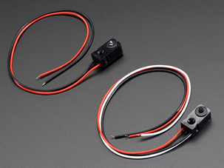
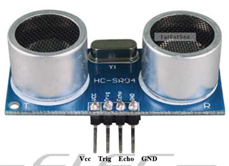
HARDWARE COMPONENTS
Arduino Uno Microcontroller board
Xbee ZigBee Module
Ping (Ultrasonic) Sensor
Infrared Sensors
Servos
Battery
Rex Robotic parts
Notes:
The Major Components are:
Xbee Module: Used to have robots communicate
Ping Sensor: Detect Objects in front of them
Infrared Sensors: Detects if one or both robots is going away from the leading robots (THIS WAS DROPPED FROM DESIGN)
Servos: Allow the moving of the wheels
Battery: We would be using a 9V rechargeable battery
Rex Robotics: Use for a base of the robot and mount the arduino

Slide 5
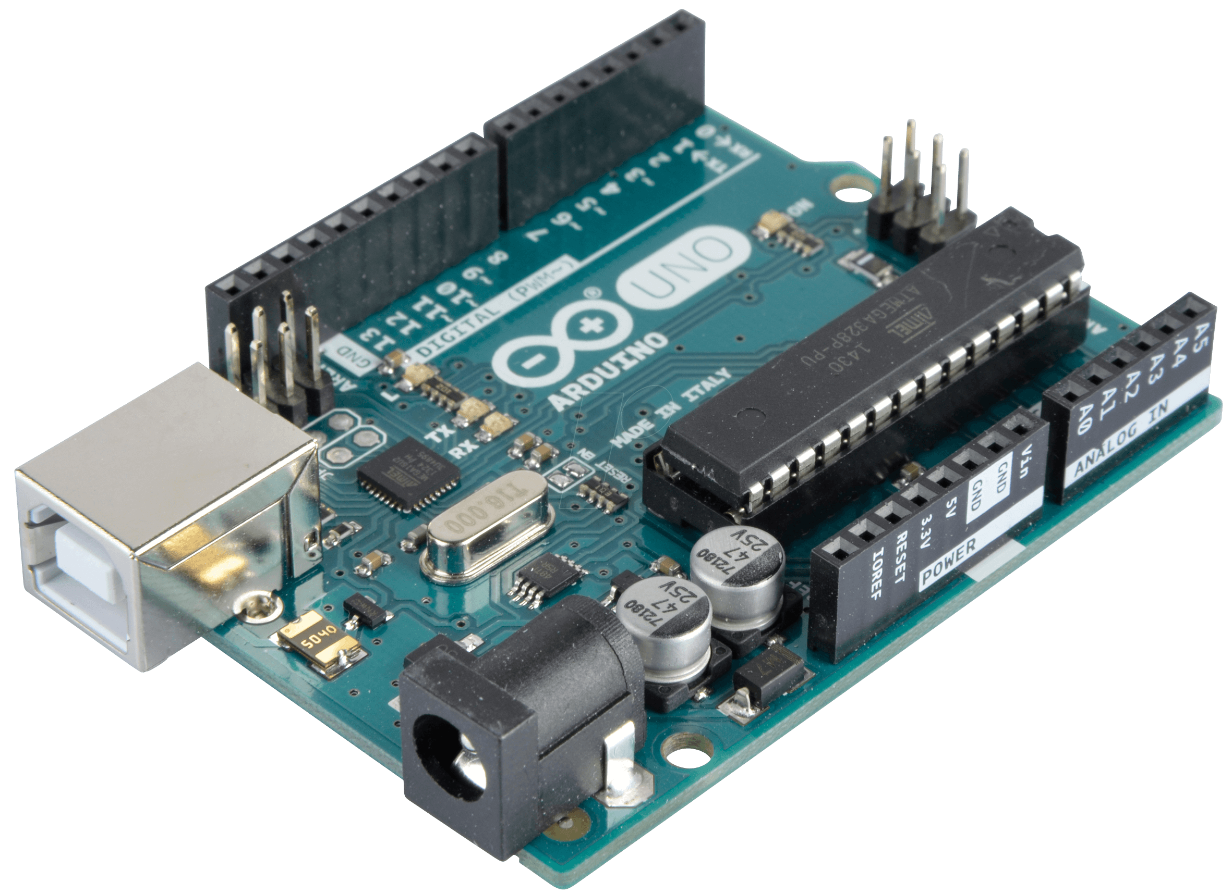
ARDUINO UNO MICROCONTROLLER
Arduino uno is a microcontroller board with 31 pins
cheap at $26 and has enough pins to control and power the components of the robot

Slide 6
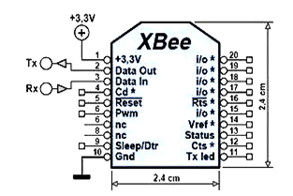
XBEE ZIGBEE MODULE
This module will connect pins to the Arduino and will send and receive signals from it.
Allow robots to communicate with each other
Notes:
We are going to use the xbee series 1 module to allow the robots to communicate together
UART communication:
universal asynchronous receiver/transmitter
sends data packets
transmit data through Tx
receives data through Rx
Using with project
each robot would have one each
the robots would communicate with each other
the leader would send the data to tell the following robots what to do and follow it
Also the following robots would send out if they have disconnected which is triggered by the infrared sensors

Slide 7
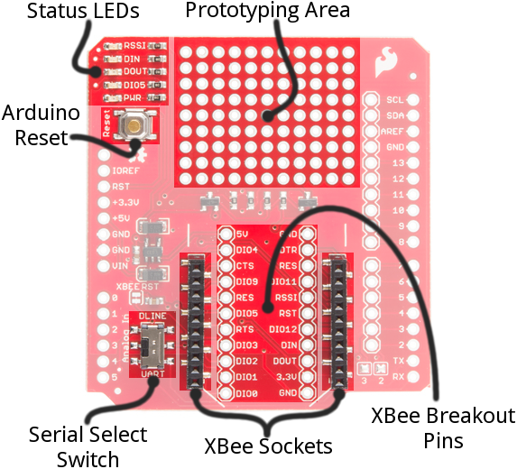
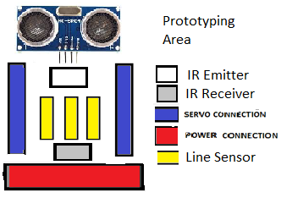
SHIELD LAYOUT
Front of Robot
Back of Robot
Notes:
This is the layout we choose to mount the components on the shield.
The Ping sensor would detect if there is an object or the robots are coming close together.
The Infrared Sensors which IR Break Beam Sensor - 3mm LEDs from adafruit:
The transmitter mounted to the front of the robot
The receiver is connected to the back of the robot
When the robots diverge from the leader, then the infrared receiver would alert the robots are not together
this would cause an interrupt to bring the robots back together.

Slide 8
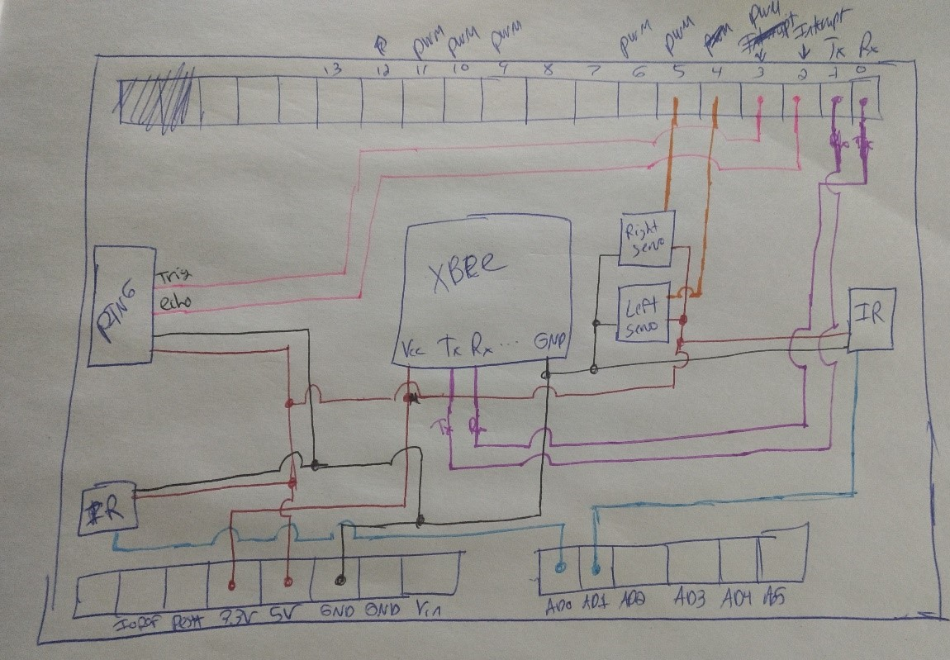
SHIELD SCHEMATIC
Notes:
This schematic is a how the components would be mounted and connected to the arduino through the shield.
The red pen is the connection to 3.3V to 5V
The black pen is the connection to ground
The other colors are the data input of the sensors:
pink for ping sensors
purple of the xbee module
blue for the Infrared sensors
orange for the servos connection

Slide 9
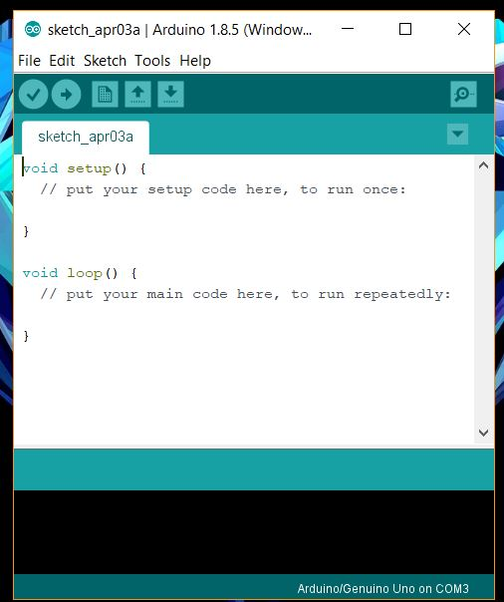
SOFTWARE
Arduino IDE for programming the arduino uno on the robot.
Arduino IDE uses a set of C/C++ functions
Notes:
We used some sample code for arduino ide support forums. To test different version of the ultrasonic sensor, motors and other sensors.

Slide 10

DELIVERABLES
Three fully functional working robots
The leader will be able to run any course asked of it.
The followers will follow the exact course the leader robot takes.
Run any track.
Be able to show that all the robots are able to get back on track.
Notes:
We would provide three fully functional working robots where one leads the other two in a line.
The three robots are capable of running any given choice with the leader robot being able to complete it but also the following robots following and doing the same actions as the leader.
The robots would also be able to get back on track together if anything causes them to diverge.

Slide 11
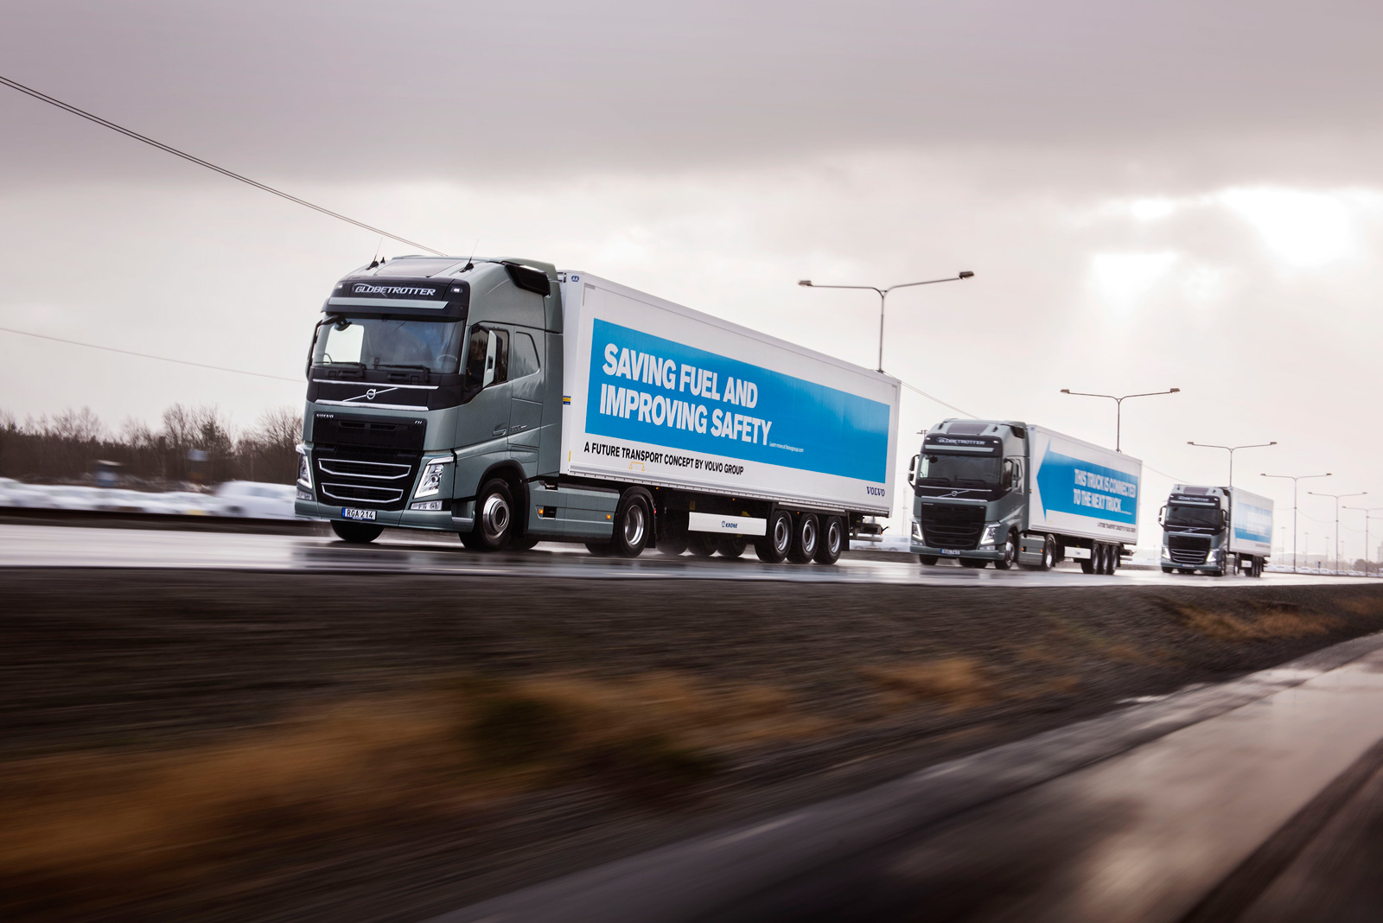
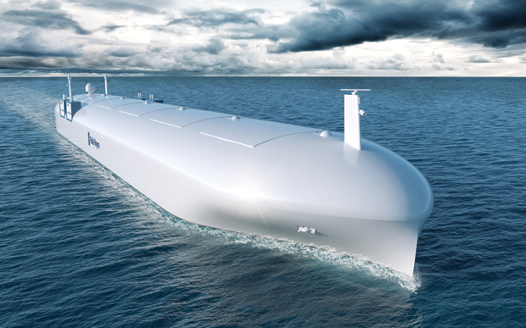
FUTURE USES
Companies needing to ship more than one truck load can supply one driver and have two autonomous trucks follow the truck with a driver.
Another use is when autonomous vehicles that require to connect to cellular network loses connection. The one with a connection can guide the disconnected cars in the route.
Creating autonomous cargo ships to follow each other great distances.

Slide 12
SOURCES
https://www.adafruit.com/product/2167
https://learn.sparkfun.com/tutorials/xbee-shield-hookup-guide
https://learn.sparkfun.com/tutorials/serial-communication
http://www.instructables.com/id/How-to-Use-XBee-Modules-As-Transmitter-Receiver-Ar/

Slide 13

QUESTIONS?

